Slide 1

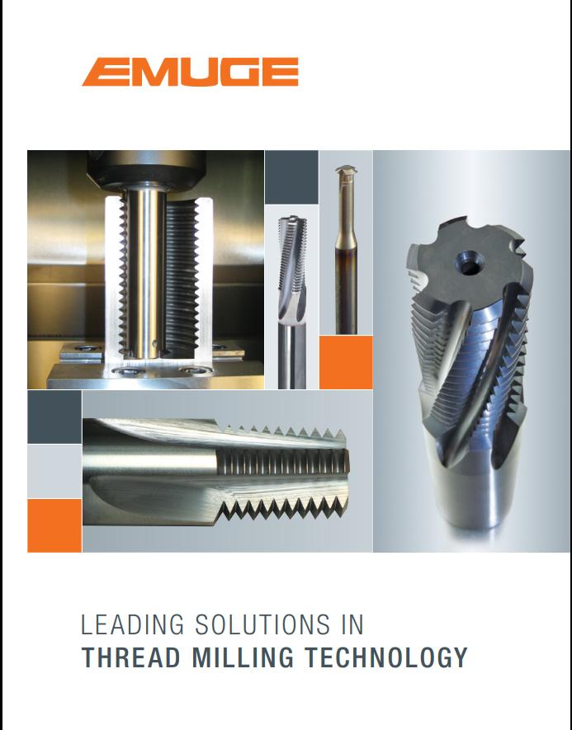
SAI SOLUTIONS Channel Partner : EMUGE-FRANKEN ( Tooling & accessories)
THREAD
MILLING
CUTTERS

Slide 2
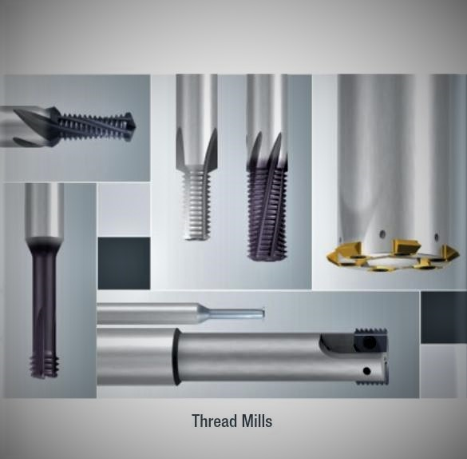

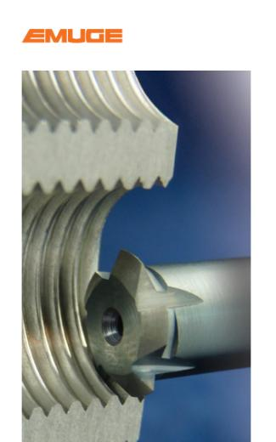

Slide 3
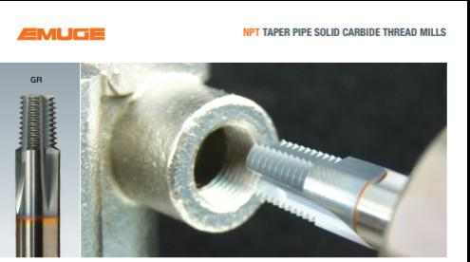
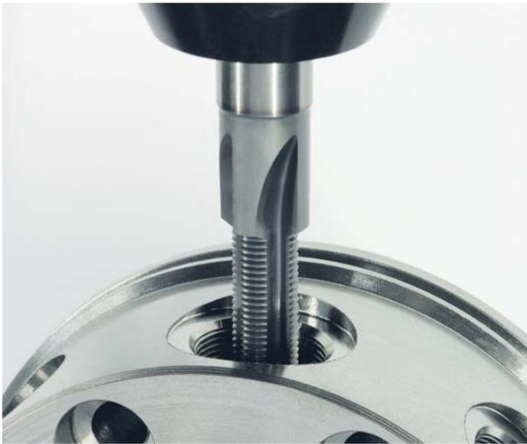
Thread Milling Cutters - Contents….
What is the Thread milling cutters?
Why Thread milling cutters required?
Types of Thread milling cutters
Comparison between Thread milling & Tapping
Advantages of Thread milling cutter.

Slide 4
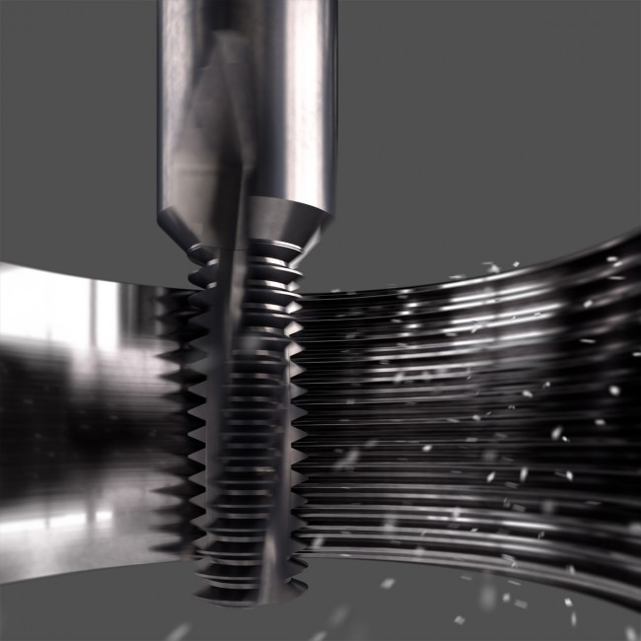
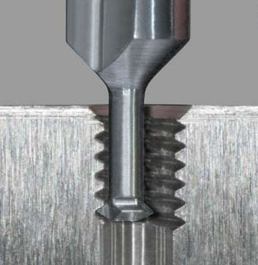
What is the Thread Milling Cutters?
Thread milling is a versatile
cost-effective process for anyone
cutting a variety of threads,
parts and work piece materials
on the same machine with
circular interpolation method.
Unlike Tapping threads produced
through milling can be machined
to full depth at high accuracy
even in hardened materials.

Slide 5
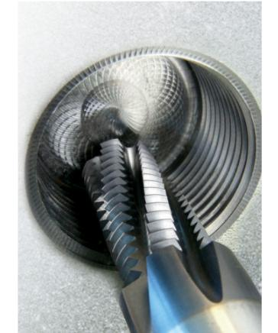
Why Thread Milling Cutters required?
Safest process.
Short chips, Hence no chip
problems.
Excellent Thread surface finish.
Single tool for RH,LH Threads.
No axial mis cut of thread.
Low cutting forces.
Thread depth can be achieved
up to bottom of the hole.
If pitch is same only one tool for
Blind hole & Through hole applications
on various thread sizes.
Possibilities to Mill External threads.

Slide 6
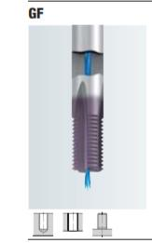
Types of Thread Milling Cutters
GF-With standard thread profile for one pitch only, we have
0.5mm – 3mm pitch range from M10 size.

Slide 7
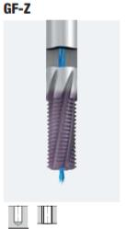
Types of Thread Milling Cutters
GF-With standard thread profile for one pitch only, we have
0.5mm – 3mm pitch range from M10 size.
GFZ-With standard thread profile for one pitch only, increased
No.of flutes optimised cutting geometry. We have 1mm – 3mm
pitch range from M14 size.

Slide 8
Types of Thread Milling Cutters
GF-With standard thread profile for one pitch only, we have
0.5mm – 3mm pitch range from M10 size.
GFZ-With standard thread profile for one pitch only, increased
No.of flutes optimised cutting geometry. We have 1mm – 3mm
pitch range from M14 size.
GFE-With corrected thread profile for single thread size only
From M5

Slide 9
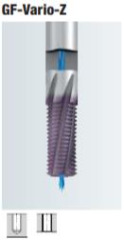
Types of Thread Milling Cutters
GF-With standard thread profile for one pitch only, we have
0.5mm – 3mm pitch range from M10 size.
GFZ-With standard thread profile for one pitch only, increased
No.of flutes optimised cutting geometry. We have 1mm – 3mm
pitch range from M14 size.
GFE-With corrected thread profile for single thread size only
From M5
GF-Vario-Z – With corrected thread profile for single thread
size only, increased no.of flutes, optimized cutting geometry.
We have 1mm – 3mm pitch range from M6 size.

Slide 10
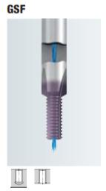
Types of Thread Milling Cutters
GSF-With corrected thread profile for single thread size only,
Threading & counter sinking done in one process from
M4 – M16 size.

Slide 11
Types of Thread Milling Cutters
GSF-With corrected thread profile for single thread size only,
Threading & counter sinking done in one process from
M4 – M16 size.
GSF-E-With corrected thread profile SPIRAL FLUTE for single
thread size only, Threading & counter sinking done in one process
from M4 – M16 size.

Slide 12
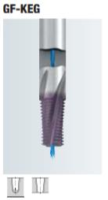
Types of Thread Milling Cutters
GSF-With corrected thread profile for single thread size only,
Threading & counter sinking done in one process from
M4 – M16 size.
GSF-E-With corrected thread profile SPIRAL FLUTE for single
thread size only, Threading & counter sinking done in one process
from M4 – M16 size.
GF-KEG -With corrected thread profile for TAPERED internal
threads.

Slide 13
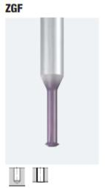
Types of Thread Milling Cutters
GSF-With corrected thread profile for single thread size only,
Threading & counter sinking done in one process from
M4 – M16 size.
GSF-E-With corrected thread profile SPIRAL FLUTE for single
thread size only, Threading & counter sinking done in one process
from M4 – M16 size.
GF-KEG -With corrected thread profile for TAPERED internal
threads.
ZGF-Single point with corrected thread profile
for machining of threads from M1 – M16 size.

Slide 14
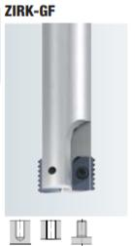
Types of Thread Milling Cutters
ZIRK-GF-Multi tooth insert cutter for one pitch only from
0.5 – 3mm pitch range from M20 size.

Slide 15
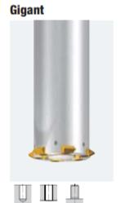
Types of Thread Milling Cutters
ZIRK-GF-Multi tooth insert cutter for one pitch only from
0.5 – 3mm pitch range from M20 size.
GIGANT-Specially for bigger thread sizes with maximum 10
Pocket 4 tooth indexable inserts having 1.5mm – 6mm pitch
Range from M24 size, with size14 cutter we can produce up
to 260mm thread depth for M80 and above sizes.

Slide 16
Comparison between Thread milling & Tapping
 | Thread Milling Process | Tapping Process
Tooling inventory | One thread mill tool covers different diameters Single tool for RH,LH Threads. Different pitches possible with indexable Thread milling cutter | Separate tap required for each hole Separate tap required for each Threads Separate tap need for each pitch
Tool Breakage | Easier to remove a broken tool from the component Reduced machine downtime | Difficult to remove broken tap from component Machine downtime will increase
Chip control | Better chip control | Chip evacuation issues
Thread Quality | Due to its shape, a Thread mill can achieve full bottom threading in a blind hole with no extra drill depth required | Drill depth is required to be maintained with in limit
Cutting material | Suitable for all material groups Machining possible up to 65HRC | With HSSE to apporox.45HRC With Carbide to approx.55HRC

Slide 17
Advantages of Thread Milling Cutters
TMC’s are only option to make big size threads with shorter machining time & higher process safety.
Produce threads with excellent form, finish and dimensional accuracy.
Common tool for all grade of materials.
Only option for Difficult to cut materials.
One tool can possible to do Internal and External threads & Right-hand and Left-hand threads.
One tool for Through hole or Blind hole.
Zero tool breakage due to chip clogging. No chipping problems.
Drilling, Threading, Countersinking can be done by one tool.
Pitch diameter can be controlled by CNC offset.
Almost ultimate possibilities to thread production as far as size and tolerance are concerned.
Zero Gauging related issues.
Hence Threading is final operation, Zero Rejection in machined component.
At the end of set life, if the tool not chipped off . We can regrind & re use the tool maximum 2 times.
Reducing new project tooling costs.
Longer tool life, Economy of space in the tool changer.

Slide 18
Your time
Thank you all. If you have still doubt in this please ask questions. It’s our pleasure to clarify your doubts.

Slide 19


